Slide 1
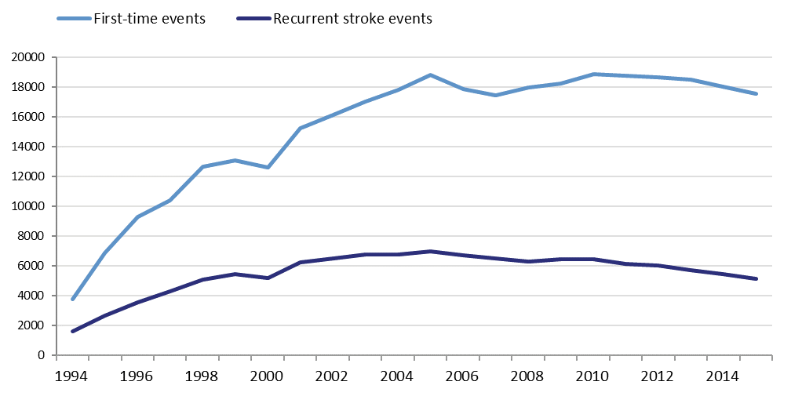
Number of stroke events in Riksstroke 1994-2015
Figure 7. Cumulative number of stroke events registered in Riksstroke from 1994 to 2015. Separate lines for first-time events and recurrent stroke events

Slide 2
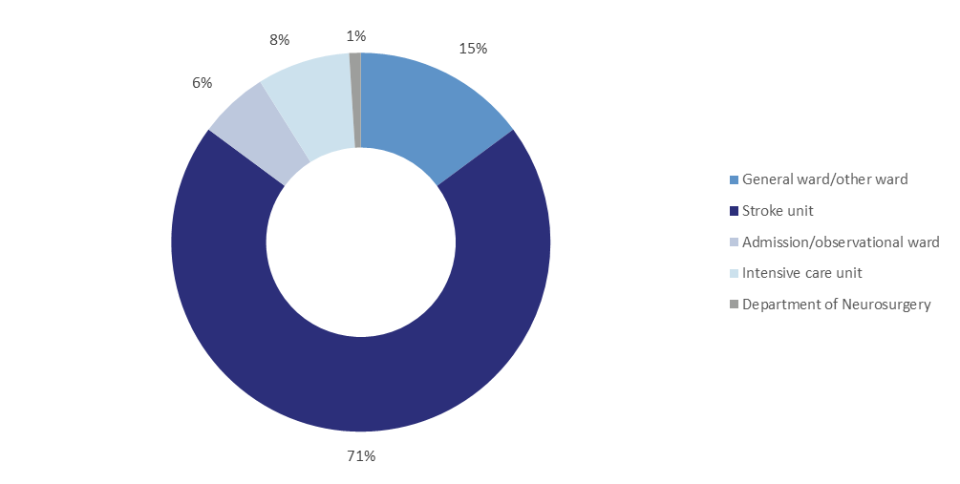
Direct admission to stroke unit or other type of ward
Figure 14. Proportion (%) of acute stroke patients directly admitted to stroke unit, intensive care unit, department of neurosurgery, or other type of ward 2015

Slide 3
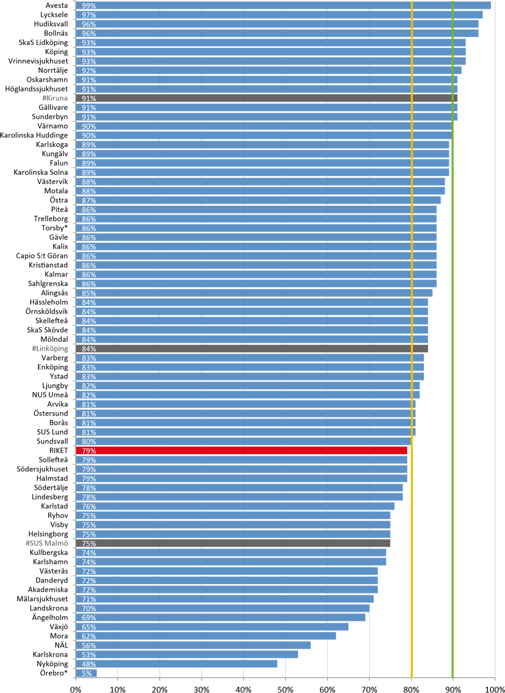
Direct admission to stroke unit
*Örebro and Torsby have declared no stroke unit in 2015
Figure 15. Proportion (%) of acute stroke patients directly admitted to stroke unit, intensive care unit, or department of neurosurgery 2015. The green line represents a high target level and the yellow a moderate target level of care. Hospitals with a coverage of less than 75 % (and therefore uncertain data) are marked with # and shaded bars

Slide 4
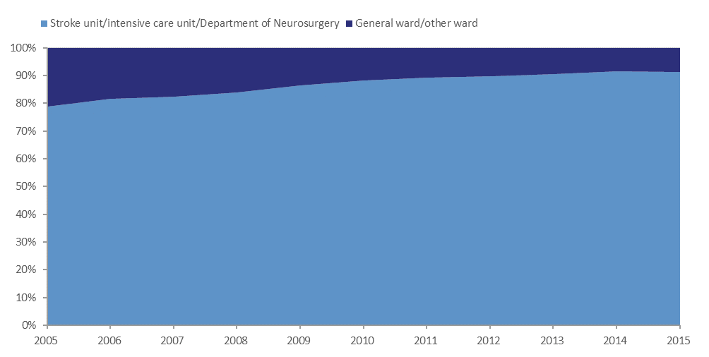
Stroke unit care (at some point during the acute phase)
Figure 16. The proportion (%) of acute stroke patients treated in a stroke unit*/intensive care unit/department of neurosurgery or in general ward/other ward, 2005-2015.
*Stroke unit at some point during the acute phase of stroke.

Slide 5
Stroke unit care (at some point during the acute phase)
Figure 17. The proportion (%) of acute stroke patients treated in a stroke unit*/intensive care unit or department of neurosurgery. Per county, 2015.
*Stroke unit at some point during the acute phase of stroke.

Slide 6
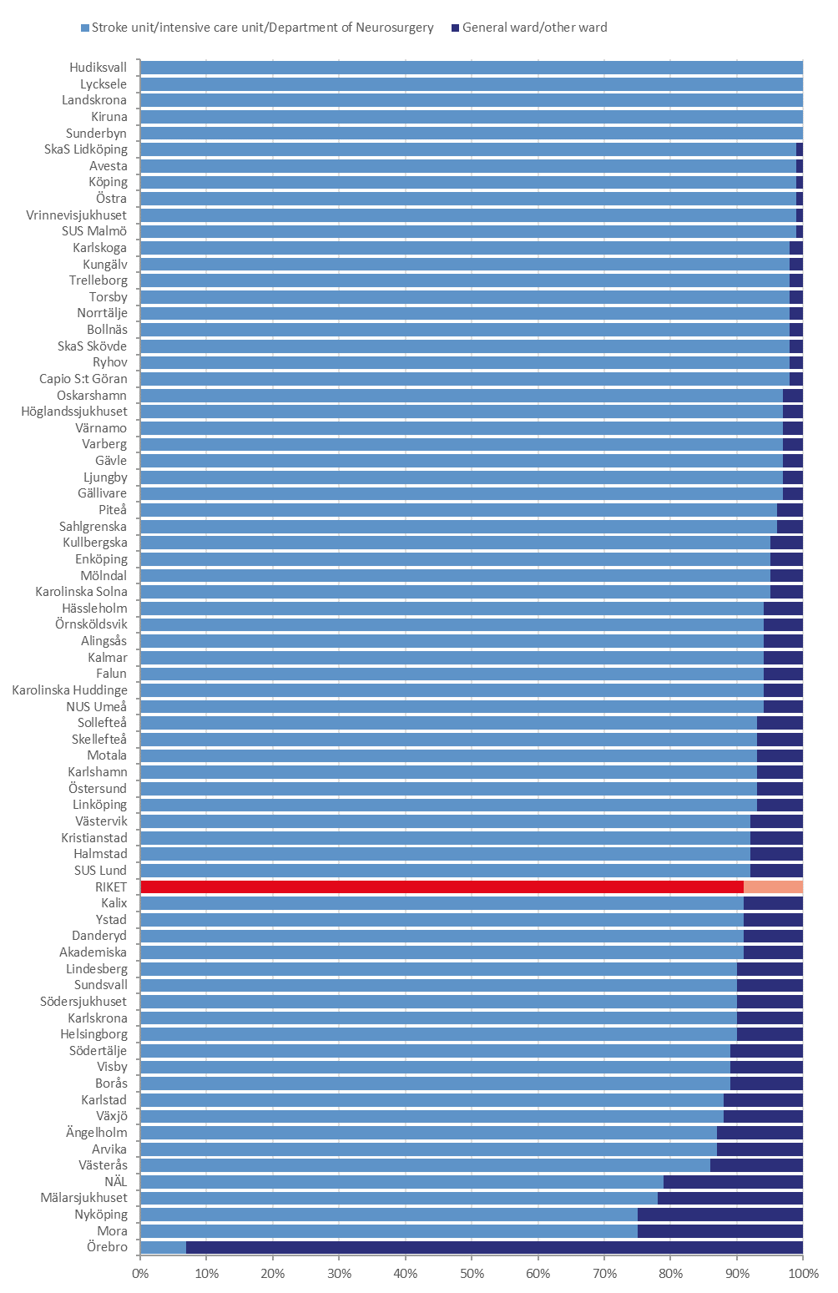
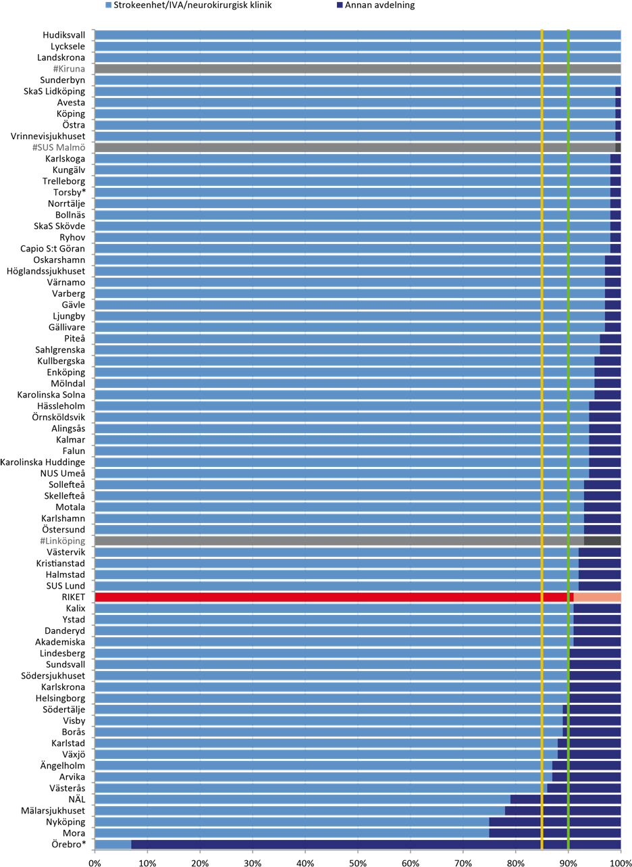
Stroke unit care (at some point during the acute phase)
*Örebro and Torsby have declared no stroke unit in 2015
Figure 18. The proportion (%) of acute stroke patients treated at a stroke unit*/intensive care unit or department of neurosurgery. Per hospital 2015. The green line represents a high target level and the yellow a moderate target level of care. Hospitals with a coverage of less than 75 % (and therefore uncertain data) are marked with # and shaded bars

Slide 7
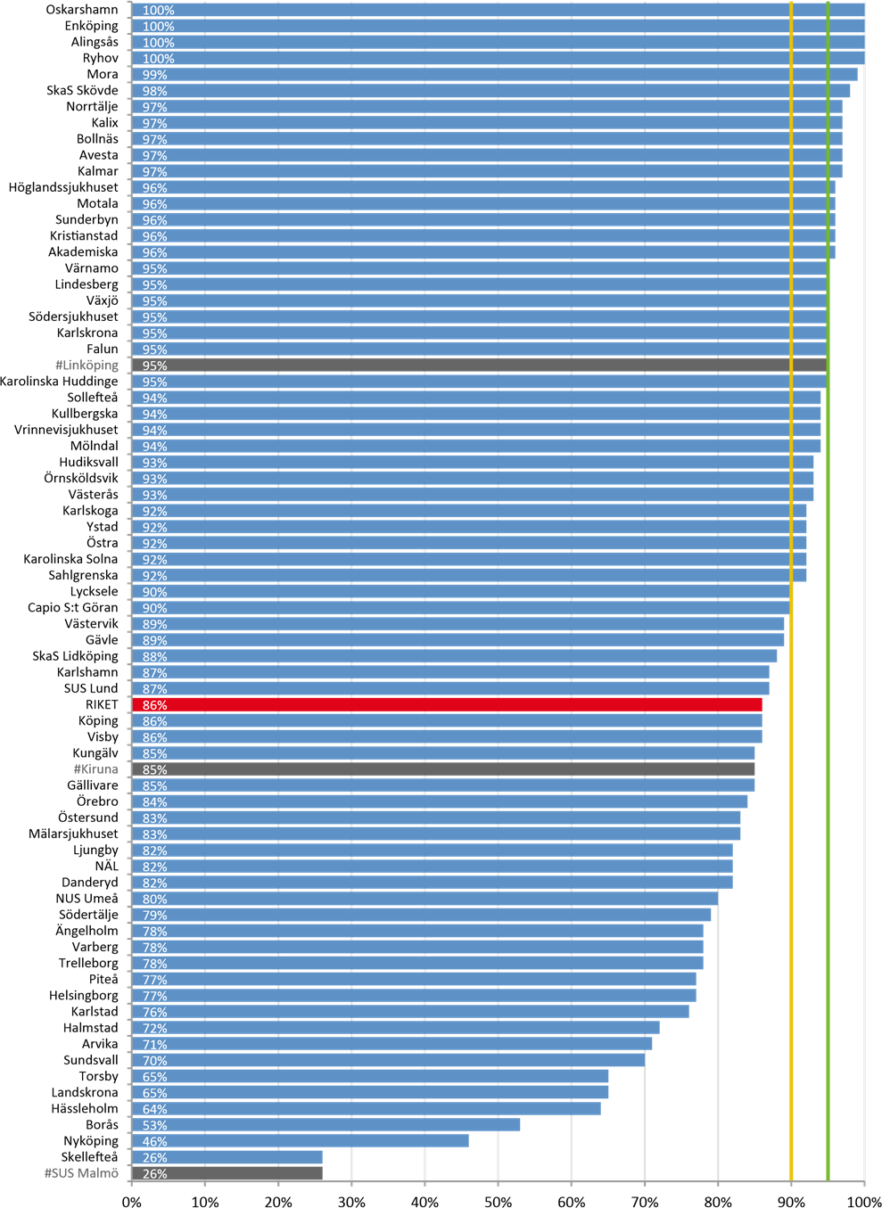
Swallowing assessment
Figure 20. Proportion(%) of stroke patients who had their swallowing assessed or were not eligible for assessment. Per hospital, 2015. The green line represents a high target level and the yellow a moderate target level of care. Hospitals with a coverage of less than 75 % (and therefore uncertain data) are marked with # and shaded bars

Slide 8
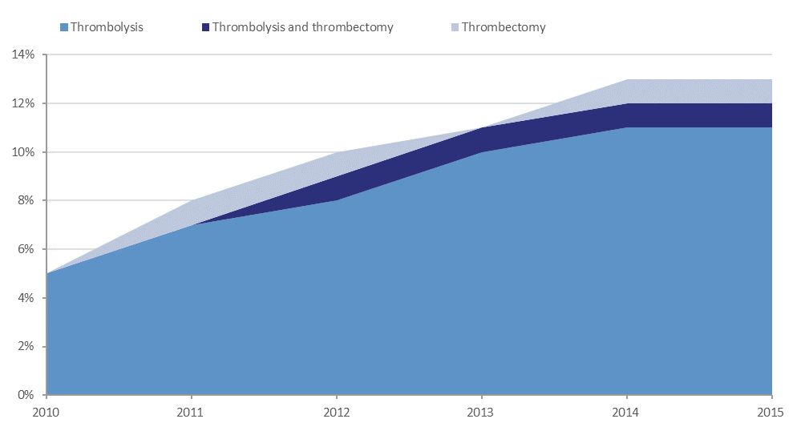
Reperfusion therapy 2010-2015
Figure 21. The proportion (%) of ischemic stroke patients who received reperfusion therapy (thrombolysis or thrombectomy), 2010-2015

Slide 9
Reperfusion therapy
Figure 24. Proportion (%) of ischemic stroke patients who received reperfusion therapy (thrombolysis and/or thrombectomy). Per county, 2015

Slide 10
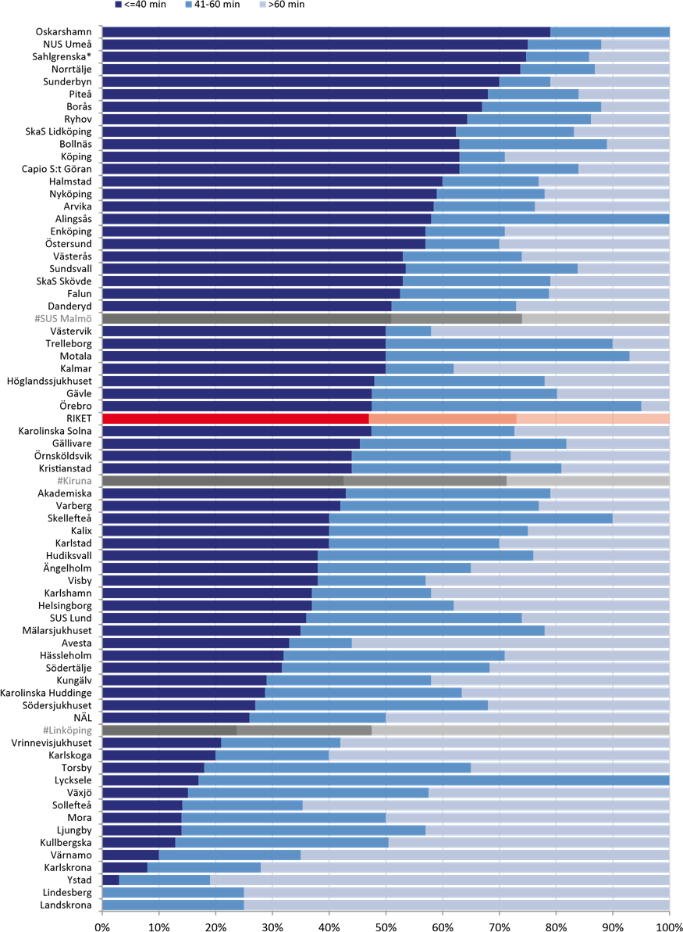
Door-to-needle times
*Mölndal and Östra are included in Sahlgrenska
Figure 26. Time from hospital arrival to start of thrombolysis (door-to-needle times). Per hospital, 2015. Hospitals with a coverage of less than 75 % (and therefore uncertain data) are marked with # and shaded bars

Slide 11
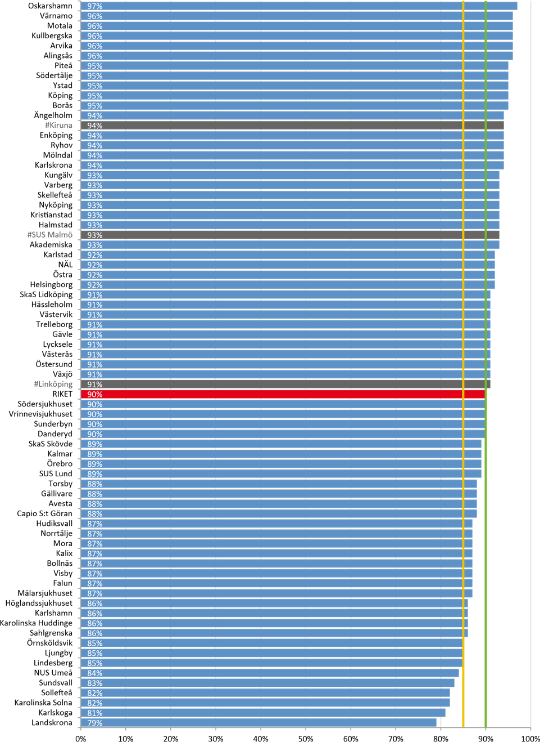
Antiplatelete treatment at discharge
Figure 28. Proportion (%) of patients with ischemic stroke and no atrial fibrillation who were prescribed antiplatelete drugs at hospital discharge. Per hospital, 2015. The green line represents a high target level and the yellow a moderate target level of care. Hospitals with a coverage of less than 75 % (and therefore uncertain data) are marked with # and shaded bars

Slide 12
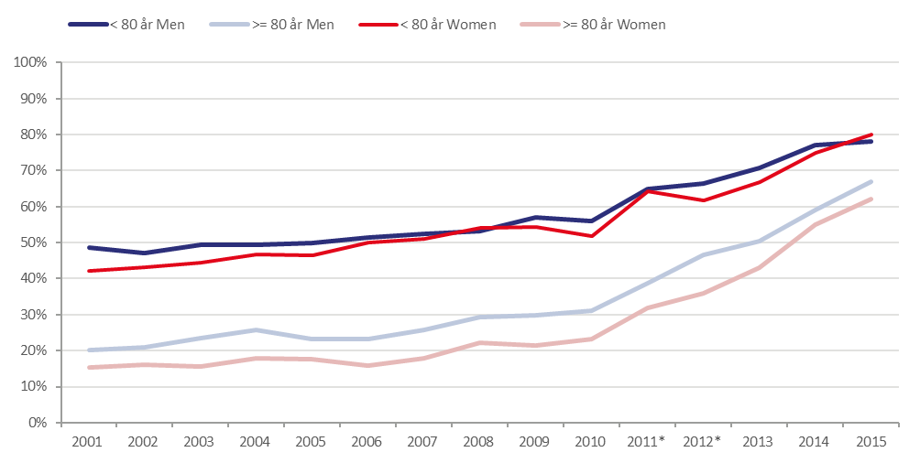
Anticouagulant treatment at discharge
*The question in the form slightly changed which could effect comparisons over time.
Figure 29. Proportion (%) of patients with ischemic stroke and atrial fibrillation who were prescribed anticoagulant treatment at discharge. 2001-2015

Slide 13
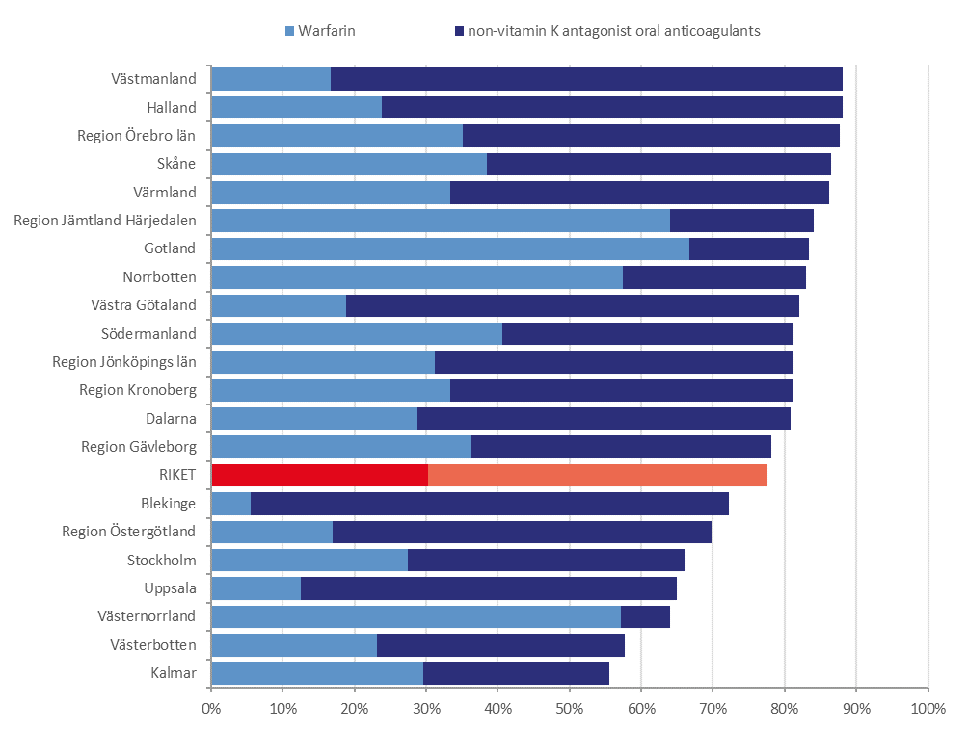
Anticoagulant treatment at discharge
Figure 30. Proportion (%) of patients under the age of 80 with ischemic stroke and atrial fibrillation who were prescribed anitcoagulant treatment at discharge (Warfarin or non-vitamin K antagonist oral anticoagulants). Per County, 2015.

Slide 14
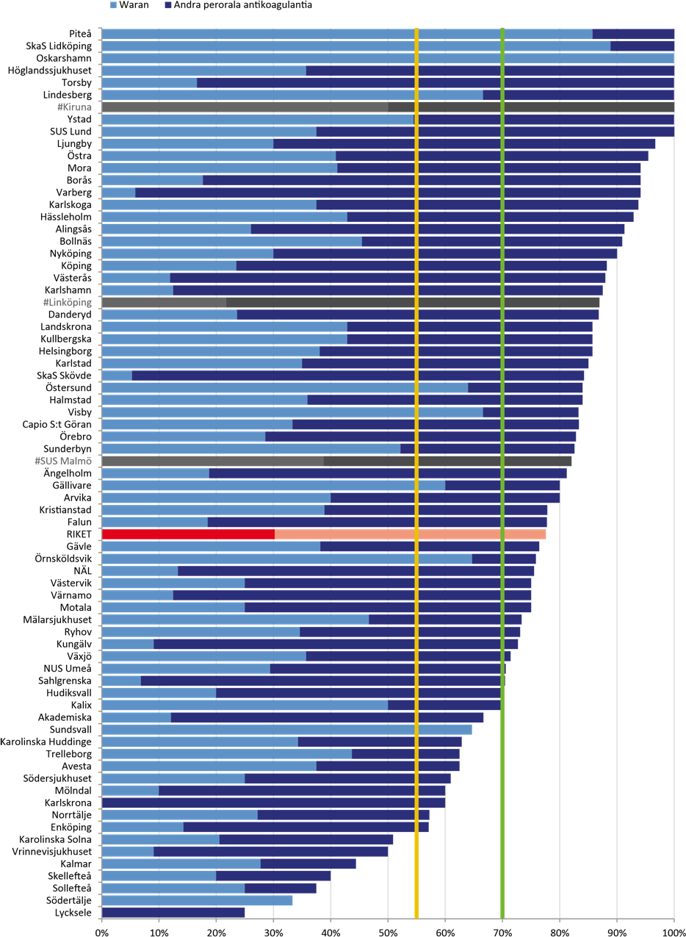
Anticoagulant treatment at discharge
Figure 31. Proportion (%) of patients under the age of 80 with ischemic stroke and atrial fibrillation who were prescribed anitcoagulant treatment at hospital discharge (Warfarin or non-vitamin K antagonist oral anticoagulants). Per hospital, 2015. The green line represents a high target level and the yellow a moderate target level of care. Hospitals with a coverage of less than 75 % (and therefore uncertain data) are marked with # and shaded bars

Slide 15
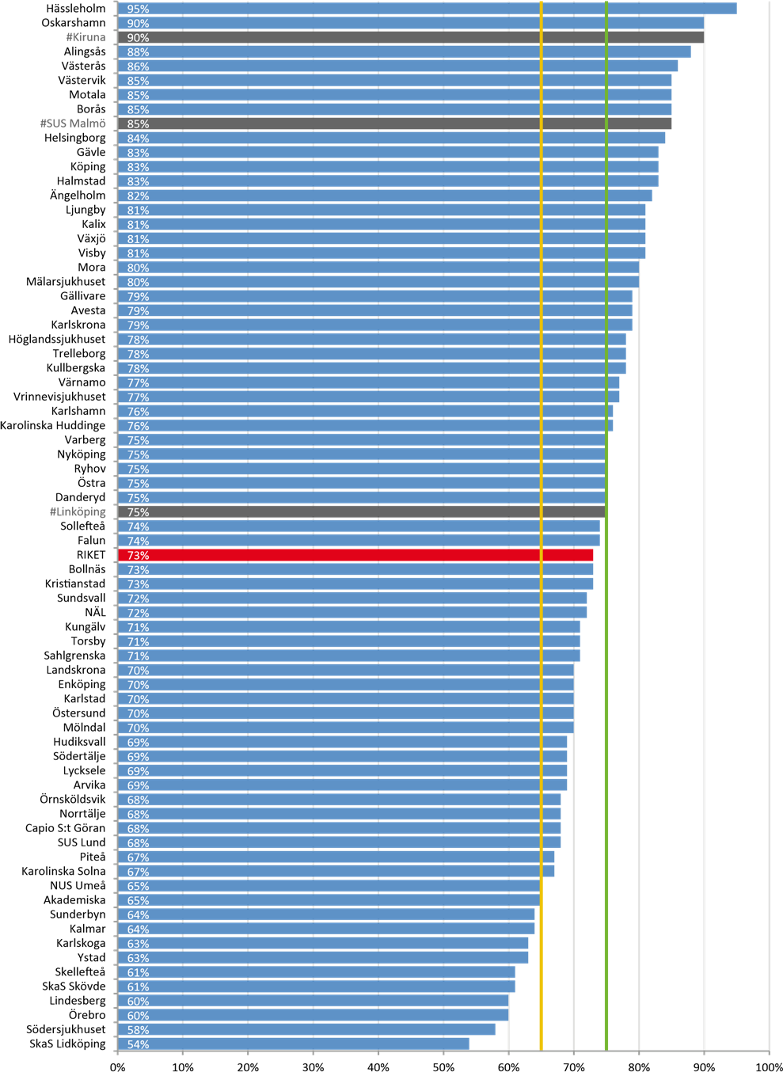
Statin treatment at discharge
Figure 33. Proportion (%) with ischemic stroke were prescribed statin treatment at discharge. Per hospital, 2015. The green line represents a high target level and the yellow a moderate target level of care. Hospitals with a coverage of less than 75 % (and therefore uncertain data) are marked with # and shaded bars

